Slide 1
Implementing Entity Framework Core in Your Solution
ENTITY FRAMEWORK CORE - Draft

Slide 2
Overview
Entity Framework Core In Action
Implementation Approaches
Code First
Database First
Take a look at EF Core Relation Mapping
One to one
One to many
Many to many
Managing Database Schemas
Model Constrains using Data Annotation

Slide 3
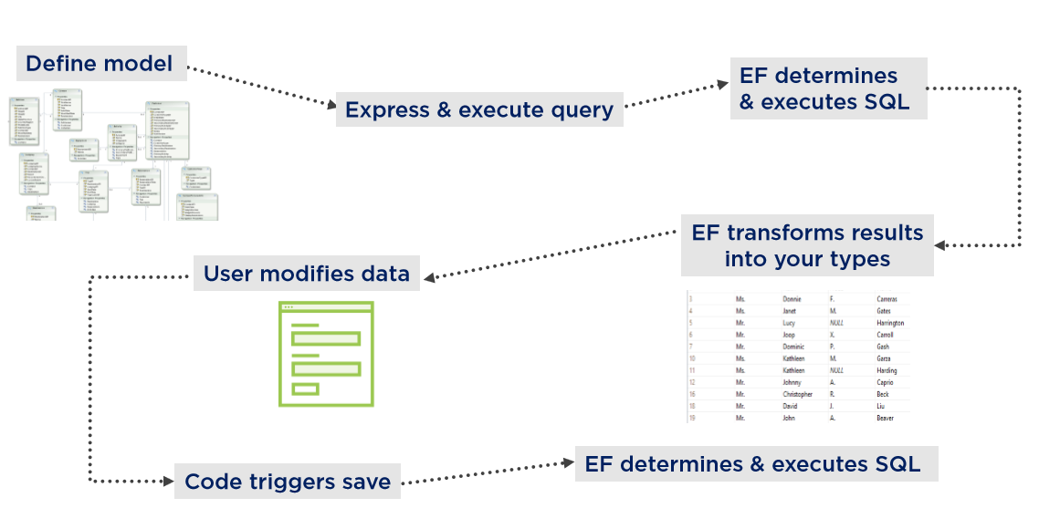
Entity Framework Core in Action
Class Students {}
SELECT * FROM students;
dbContext.Students.ToList();
Model binding
UPDATE students SET ‘name’ = …
dbContext.SaveChangesAsync();

Slide 4
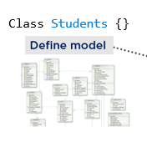
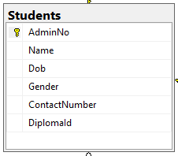

Components Involved
Data Model
Database Context
Model is a conceptual model of an application's domain.
The domain includes all topics relevant to the problem solving areas of interest to the application users.
DbContext class represents a session with a database and provides an the following capabilities:
Database Connections
Data operations/CRUD
Change Tracking
Data Mapping
Transaction management

Slide 5
Implementation Approaches
Code First
Database First
For new database
Focuses on Model building
EF core tool will generate the database
For existing database
EF core tool will generate and create data model and context

Slide 6
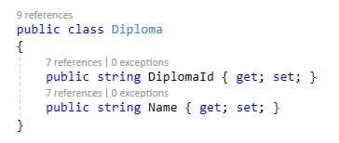
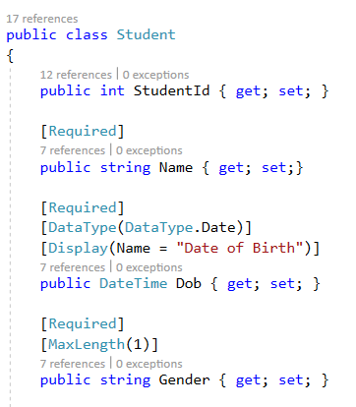
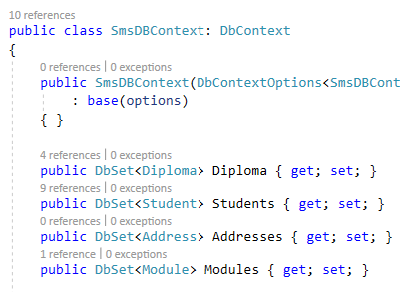
Code First
1. Build data model and context
Take Note: The data type matters!
C# Data Type | SQL Data Type
String | nvarchar(MAX)
int | Int
datetime | datetime2(7)
*More advance sql data type configuration will require the use of Data Annotation.
Notes:
Basically define all your object classes

Slide 7
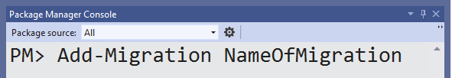
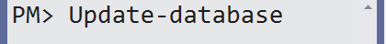
Code First
2. Create Checkpoint
2. GENERATE DATABASE
Migrations in EF Core provides a way to incrementally update the database schema to keep it in sync with the application's data model while preserving existing data in the database.
Like a checkpoint
This then apply the migration to the database to create the schema.
Notes:
Build your data model first, define all your objects, fields, is it required, string length etc.
Then use the migration command to create a checkpoint for database context
Use update-database command to generate the actual database schema in sql server

Slide 8
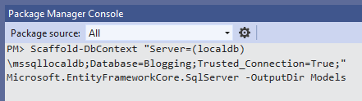
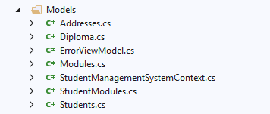
Database First
1. scaffolding/Reverse Engine Database
2. Generated Files
Run Scaffold-DbContext command in package manager console.
Supply database connection string.
Model and Database context will be generated automatically.

Slide 9



Implementation Approaches
Code First
Database First
Both approach will give you
Data Model
Database
Context
Notes:
Both will result in this to advance your project

Slide 10
Managing Database Schemas
Decide Source of truth:
Database schema or Data model
Simply go through the steps for setting up database schema for code first or database first approach again.
The updated model/database will be generated accordingly.
Data Model
Database
What if I change the model or database schema?

Slide 11

Take a look at EF Core Relation Mapping
EF core support complex table relationships:
One to One
One to Many
Many to Many
Two ways to define entity relationships:
Define in data model (a.k.a conventions)
Define in database context
Notes:
Conventions means by creating the require properties, ef core will automatically identify and create the mapping relationship

Slide 12
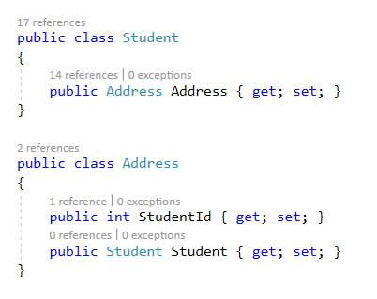
Conventions: One to One Relationship
One to one relationship of student address entity.
Here each student will only have one address detail and each address detail will only belong to one student.
Reference navigation property
Foreign Key
Reference navigation property

Slide 13
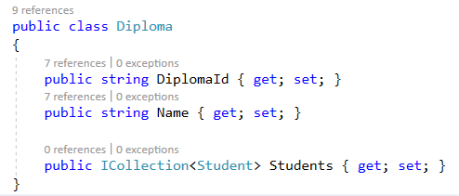
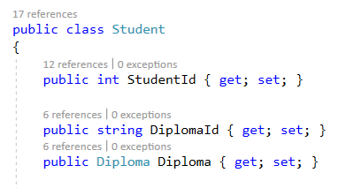
Conventions: One to Many Relationship
One to Many relationship for students enrolled in diplomas.
Here diploma can have many students while students can only be enrolled in one diploma.
Collection navigation property
Foreign Key
Reference navigation property

Slide 14
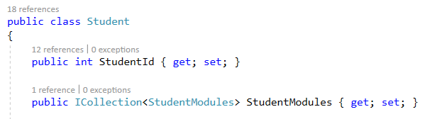
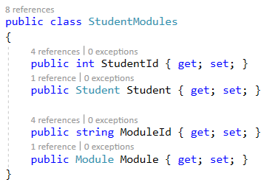
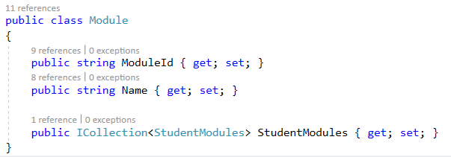
Conventions: Many to Many Relationship
Many to many relationship for student course modules.
Here modules can have many students and student can have many modules.
One to Many
One to Many
A Join Table Class is Needed

Slide 15
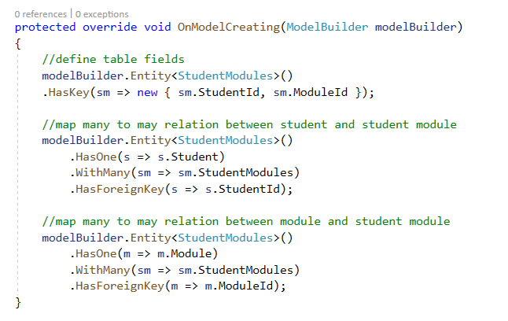
Conventions: Many to Many Relationship
As student module class is a join table class, we will need to define the join relationship in database context using fluent API.
Student Module
Composite Key
One to Many Relationship between Student and Student Module
One to Many Relationship between Module and Student Module

Slide 16
SQL Constrains using Data Annotation
Similar to SQL, the data models can use Data Annotation to enforce rules on each model properties.
Allow NULL
String Length etc
Not only SQL constrains, data annotation can be useful for defining other behaviours such as:
Alias
To be excluded in mapping
Regex
Useful for form validation
Notes:
Enforcing database constrains such as primary/foreign keys, null, varchar length etc
All rules defined will be useful when creating form, validation is automated

Slide 17
Data Annotations for Database Schema
Annotation | Function
Table | The database table and/or schema that a class is mapped to. [Table(“different_table_name_instead_of_book")] public class Book{ … }
Column | The database column that a property is mapped to. [Column("Description", Order = 2, TypeName = "nvarchar(100)")] public string Title { get; set; }
ForeignKey | Specifies the property is used as a foreign key in a relationship. [ForeignKey("Author")] public int AuthorFK { get; set; }

Slide 18
Data Annotations for Database Schema
Annotation | Function
DatabaseGenerated | Specifies how the database generates values for a property. [DatabaseGenerated(DatabaseGeneratedOption.Computed)] public DateTime LastAccessed { get; set; }
NotMapped | Applied to properties or classes that are to be excluded from database mapping. [NotMapped] public string FullName => $"{FirstName} {LastName}";

Slide 19
Data Annotations for Database Schema
Annotation | Function
InverseProperty | Specifies the inverse of a navigation property when you have conflicting navigation properties public class Contact { public User CreatedBy { get; set; } public User UpdatedBy { get; set; } } public class User { [InverseProperty("CreatedBy")] public List<Contact> ContactsCreated { get; set; } [InverseProperty("UpdatedBy")] public List<Contact> ContactsUpdated { get; set; } }

Slide 20
Data Annotations for Attributes
Annotation | Function
Key | Identifies one or more properties as a Key. [Key] public int OrderNumber { get; set; } * Ef core will automatically create key for properties ending with “ID”
Timestamp | Specifies the data type of the database column. [TimeStamp] public byte[] RowVersion { get; set; }

Slide 21
Data Annotations for Attributes
Annotation | Function
ConcurrencyCheck | Specifies that the property is included in concurrency checks for WHERE/UPDATE/DELETE statements. [ConcurrencyCheck] public string FirstName { get; set; } [ConcurrencyCheck] public string LastName { get; set; }
Required | Specifies that the property's value is required. Provide client-side validation as well. [Required] public string Title { get; set; }

Slide 22
Data Annotations for Attributes
Annotation | Function
MaxLength | Sets the maximum allowed length of the property value (string or array). [MaxLength(150)] public string Title { get; set; }
StringLength | Sets the maximum allowed length of the property value (string only) [StringLength(150)] public string Title { get; set; }
And many more annotations, find out more at Ef 6 doc (same usage as Ef core):
https://docs.microsoft.com/en-us/ef/ef6/modeling/code-first/data-annotations

